Slide 1


Melanoma Detection Assignment
- Anjali Vashisth

Slide 2


We will Cover
Loading Images
Create Model
Train Model
Test Model
Submission
Conclusion

Slide 3
Loading Images
As I’m using a low power laptop, so had run the assignment in Kaggle online platform, a dataset was uploaded online from ,skin-lesion-analysis-toward-melanoma-detection.
UpSampling for done for under-represented data
Generators used – categorical class mode
Check first 32 images of a batch shown in next slide

Slide 4
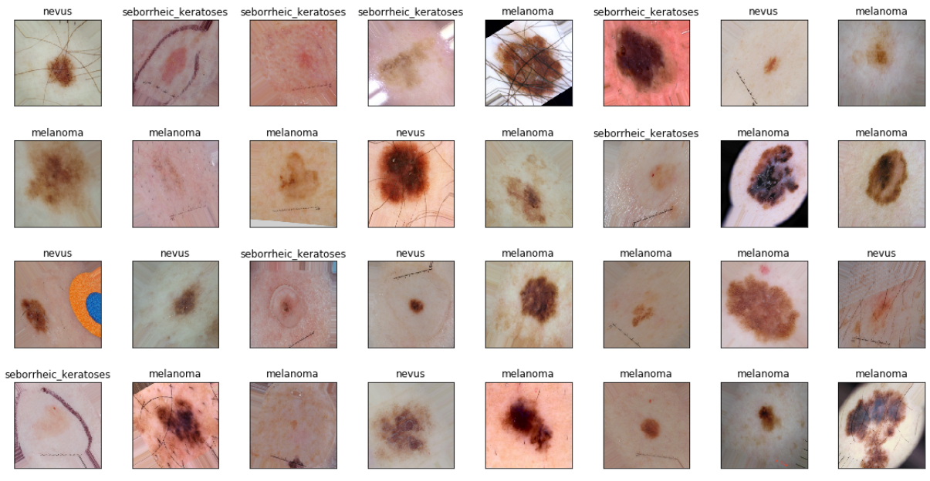

Slide 5
Creating Model
add a global spatial average pooling layer
add a fully-connected layer and logistic layer
Compile Model

Slide 6
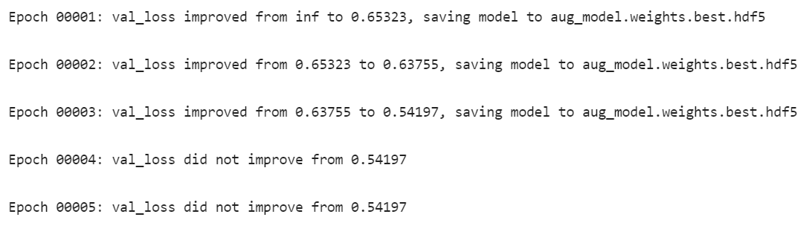
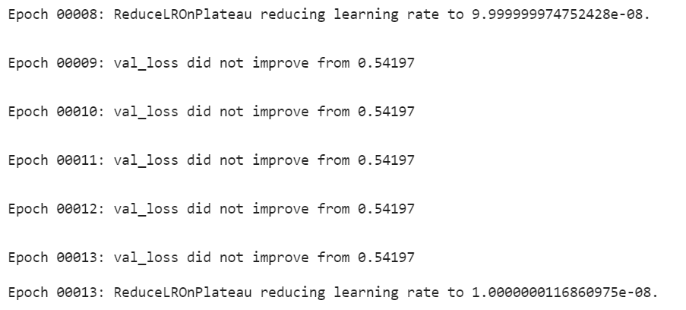
Training Model

Slide 7
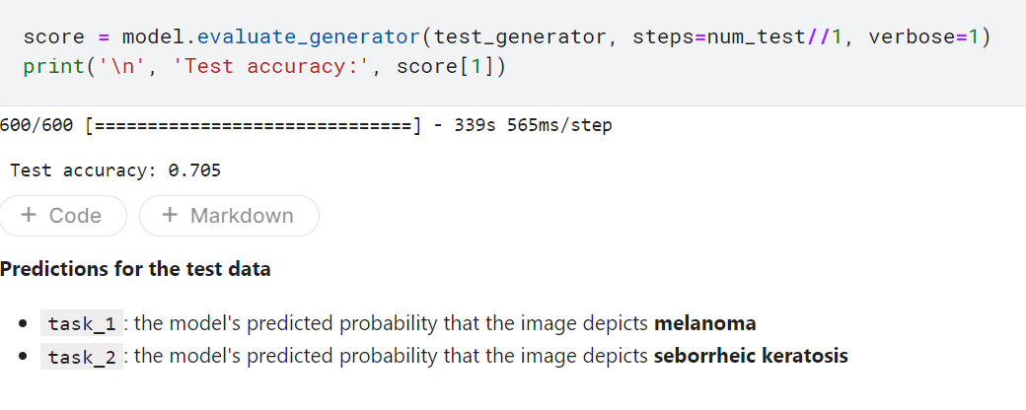

Testing Model

Slide 8
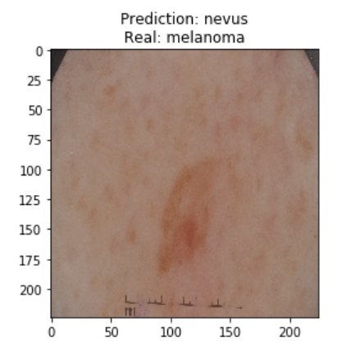
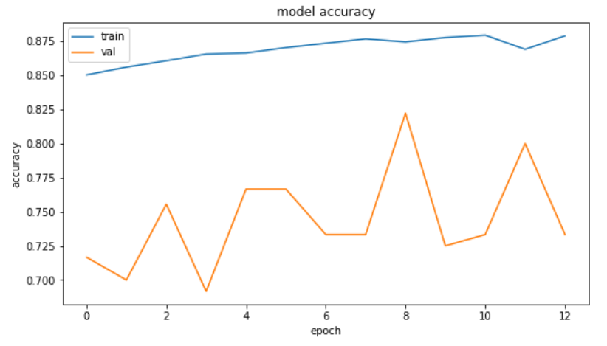
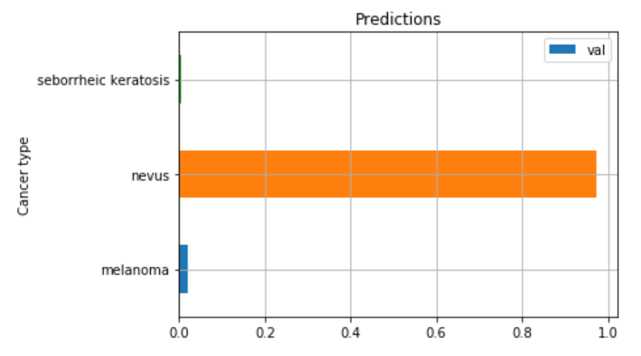
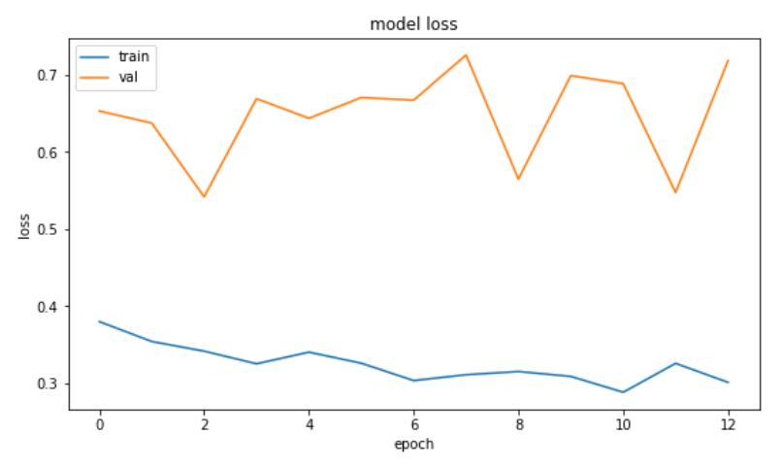
Visualizing

Slide 9
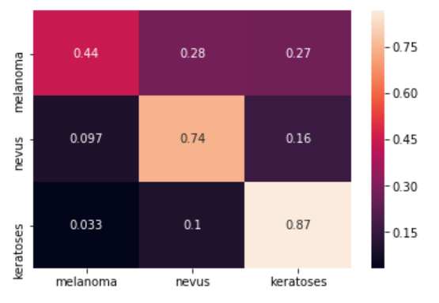
Confusion Matrix

Slide 10
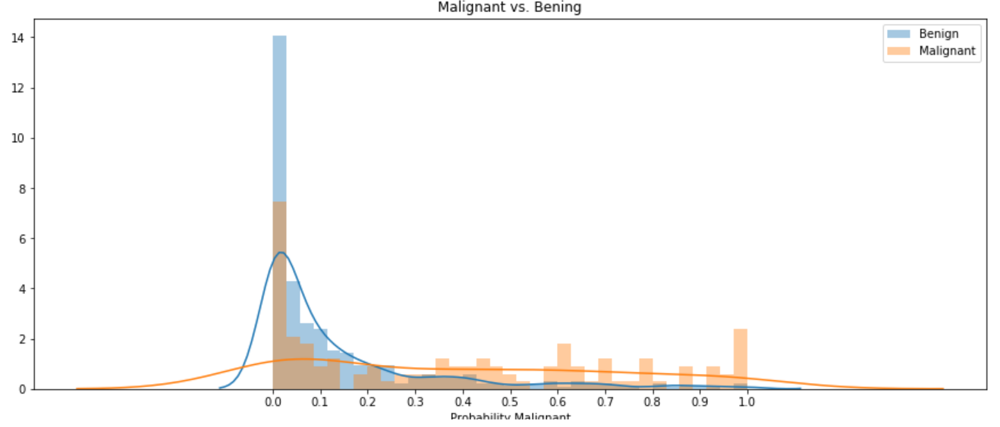
Probability Malignant

Slide 11
Thank You

